Slide 1
Infrastructure Automation with Terraform & Azure Devops on Azure cloud
Harshal Mittal

Slide 2
Explicit Dependencies Section 7
Notes:
Lets learn about Explicit dependencies

Slide 3
Explicit Dependencies
Terraform user defines ths type of dependency.
Notes:
Explicit dependencies
Explicit dependencies is defined by terraform user by using the depends_on meta-argument.

Slide 4
Explicit Dependencies
Terraform user defines ths type of dependency.
Using the depends_on meta-argument in resource block
Notes:
Explicit dependencies are used when Terraform can't "see" an implicit dependency or when you want to override the default execution plan. In these scenarios, use the depends_on meta-argument to explicitly define these dependencies. The depends_on meta-argument accepts a list of resources.

Slide 5
Explicit Dependencies
Terraform user defines ths type of dependency.
Using the depends_on meta-argument in resource block
Example
resource "azurerm_subnet" “sub01" {
}
resource "azurerm_network_interface" “nic01" {
depends_on=[azurerm_subnet.sub01]
}
Notes:
Example, there are 2 resource blocks subnet and network interface, so if you want to define an explicit dependency then you can use depends on, it is a list of resources, so using square bracket and passing the resource on which it is depending.

Slide 6
Explicit Dependencies
Terraform user defines ths type of dependency.
Using the depends_on meta-argument in resource block
Example
resource "azurerm_subnet" “sub01" {
}
resource "azurerm_network_interface" “nic01" {
depends_on=[azurerm_subnet.sub01]
}
Notes:
So that is the syntax to define explicit dependency, this line of code tells terraform that nic depends on subnet. So the subnet will be deployed first and then network interface.

Slide 7
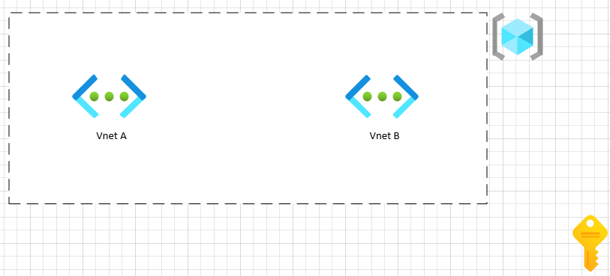
Example of Explicit Dependency
Notes:
Here I have an example of Explicit dependency,
where we are going to deploy 2 vnets in a resource group, both vnets depends on resource group using implicit dependency only so vnets will be deployed after the resource group deployment. But if you would like terraform to deploy vnet-b only after vnet-a, in that case we can override terraform behaviour and define the dependency in vnet-b resource block depends on vent A. we can also use dependency graph to trouble shoot, where terraform unable to determine the order of deployment.

Slide 8
Demo
The output of terraform graph is in the DOT format, which can easily be converted to an image by making use of dot provided by Graphviz. Terraform graph | dot -tsvg > graph.Svg
Download graphviz and install it on you workstation to convert a dot format file into image.
Notes:
About lab.
There is a command to see the dependency graph of resources, which you can see by running terraform graph command. Let us use this example in our demo and see how dependency graph will show you the changes.
Download graphviz and install it on you workstation to convert a dot format file into image.

Slide 9
Managing Multiple Environments Using Workspaces
Next video
Notes:
Now we have about dependencies, lets us learn about various ways of managing multiple environments in the next video. Stay tunned.

